Slide 1

Nano-Helper
Yoselin

Slide 2
Business Case: Nano – Helper
Business Description
Business Goal
Located in the High Desert
Develop beginning of Covid-19
For parents who prefer to stay home
Service provide with daily task:
House Keeping
Errands
Sitter
Help our community during COVID-19 Pandemic.
Expand our business into the county of San Bernardino

Slide 3
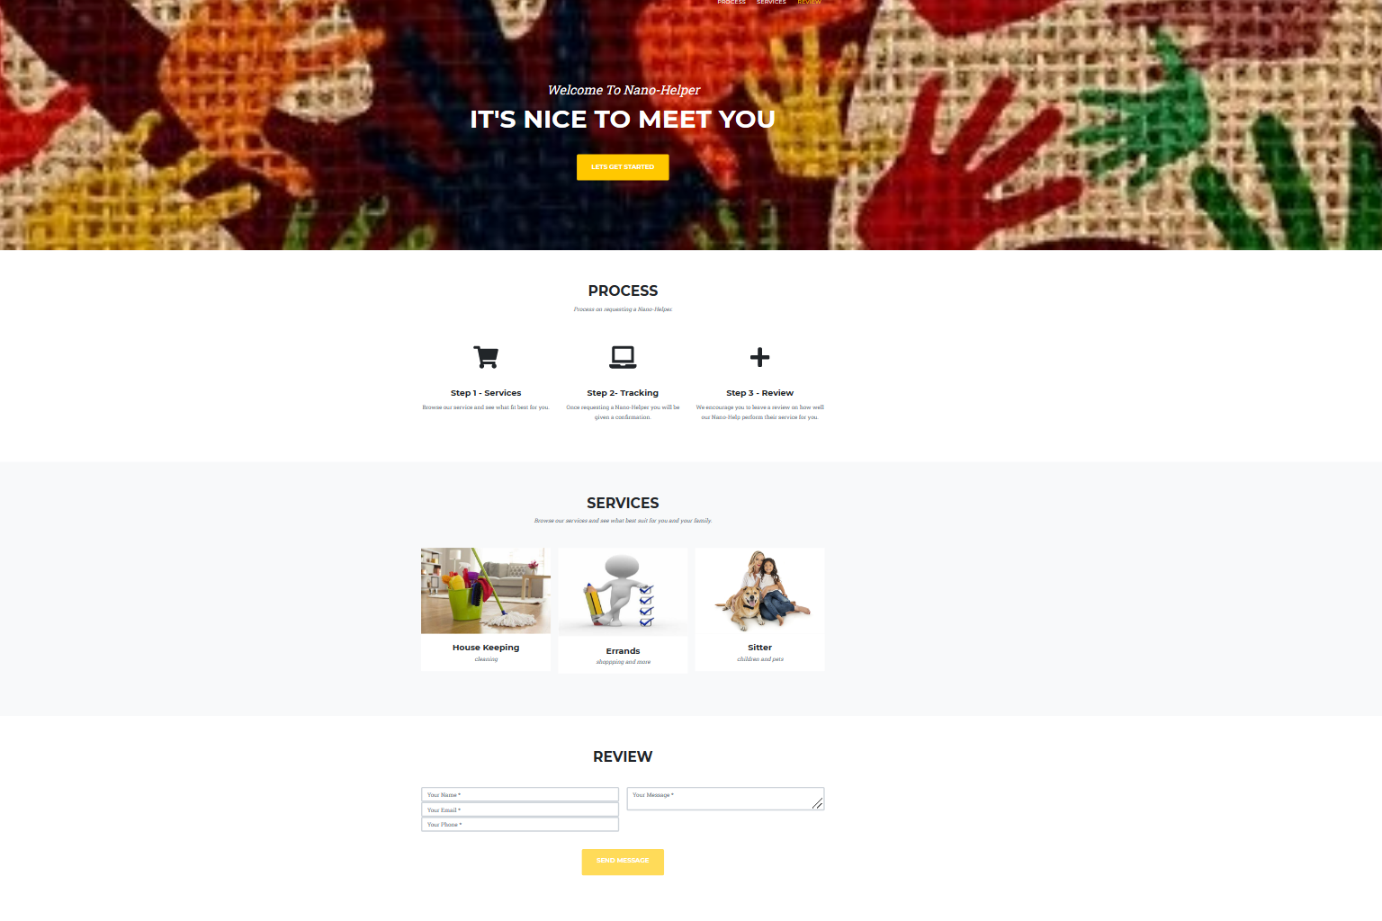
Demo: Web - Application
Nano-Helper

Slide 4
Challenge and Solutions
Challenges:
Image Size/Image Property
Outline
To Broad
Reading material
Yellow plus symbols
Solution:
Change property or search another photo
Service
Focus on 3 main task
Download another templete

